Slide 1
Fuzzing Semantic Misinterpretation for Voice
Assistant Applications
Project Proposal
Presented by
Shivam Pandit Christin Wilson

Slide 2
Introduction
Security Concerns in Voice Assistants
Semantic Misinterpretations: VA’s are found to misclassify things based on speech understanding that can cause security concern
Attacks on ASR & Intent Classifier: Attacks on Automatic Speech Recognition and intent classifier are big concern as attackers leverage common spoken errors to breach vApp integrity for malicious intent
NLU’s Intent Classifier
Intent Classifier may misinterpret something other than user intent based on machine understanding
Fuzzing Semantic Misinterpretation for Voice Assistant Applications
Slide 1

Slide 3
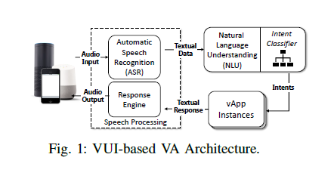
Introduction
VUI based VA Architecture
Fuzzing Semantic Misinterpretation for Voice Assistant Applications
Slide 2

Slide 4
Introduction
Security Aspects
Voice assistants allow us to directly control computational devices like phones, tablets that emphasizes need of security.
User voice commands can be misinterpreted by NLU intent classifier to give undesired results.
ASR and intent classifier are both proven to misinterpret the spoken command by users that can be leveraged by hackers to intrude privacy.
Some Developers can maliciously modify intent matching process in NLU.
Intent classifier plays more important role since it is last step of the interpretation process.
Fuzzing Semantic Misinterpretation for Voice Assistant Applications
Fuzzing Semantic Misinterpretation for Voice Assistant Applications
Slide 3

Slide 5
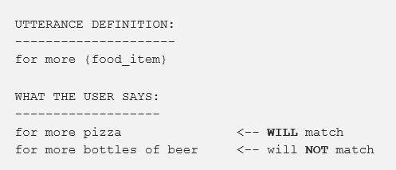
Introduction
Examples
The actual word used in the utterance matters as seen above.
Machine learning algorithm considers the number of words in the utterance, the utterance word itself, as well as the number of words in each sample slot.
Fuzzing Semantic Misinterpretation for Voice Assistant Applications
Slide 4

Slide 6
Attack Consequences
Denial of Service
Privacy Leakage
Phishing
Other consequences
Introduction of new functionalities like in-vApp purchasing can cause new consequences.
Early-Stage Malware Prediction Using Recurrent Neural Network
Fuzzing Semantic Misinterpretation for Voice Assistant Applications
Slide 5

Slide 7
Related Work
Attacking ASR through Acoustic Channels
Launch Attacks that can be recognized by a computer speech recognition system but not easily understandable by humans.
Attacking ASR with Misinterpretation.
vApp Squatting Attack
Uses a malicious skill with similarly pronounced name or paraphrased name to hijack the voice command meant for a different skill.
Early-Stage Malware Prediction Using Recurrent Neural Network
Fuzzing Semantic Misinterpretation for Voice Assistant Applications
Slide 6

Slide 8
Implementation
Creating BN Models
Linguistic Knowledge is collected and Bayesian Networks are formulated.
Mispronunciation, Grammar and Vocabulary are considered.
Collecting SEED inputs
Crawl skill commands from Alexa Skill Store and preprocess them for mutation.
Perform Mutation
Evaluate
Fuzzing Semantic Misinterpretation for Voice Assistant Applications
Slide 7

Slide 9
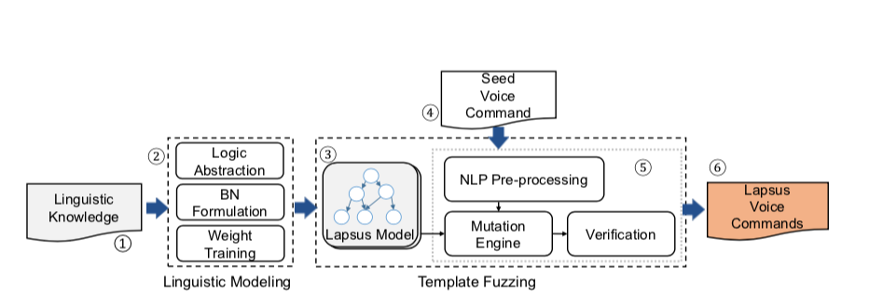
Implementation
Fuzzing Semantic Misinterpretation for Voice Assistant Applications
Slide 8

Slide 10
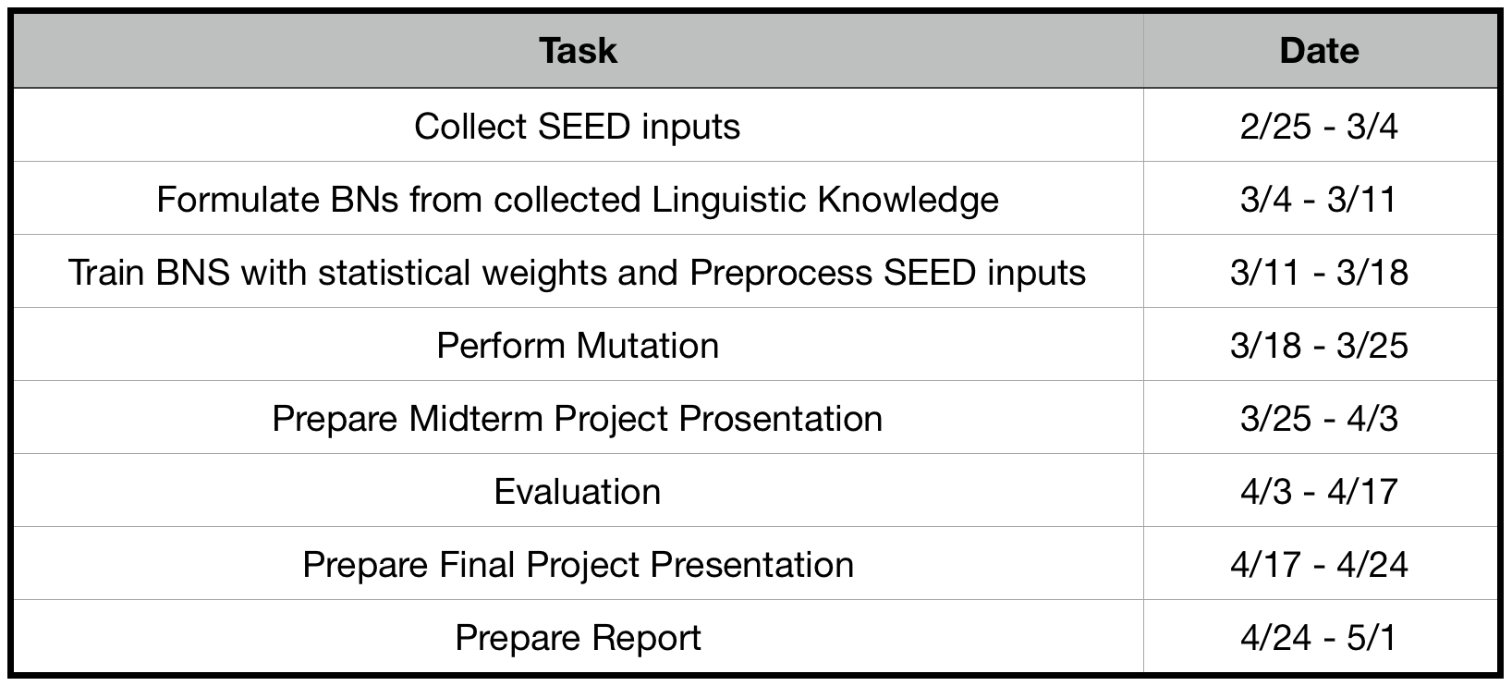
Timeline
Fuzzing Semantic Misinterpretation for Voice Assistant Applications
Slide 9

Slide 11
THANK YOU..
Questions??
Early-Stage Malware Prediction Using Recurrent Neural Network
Fuzzing Semantic Misinterpretation for Voice Assistant Applications
Slide 10

